Slide 1

Trade Finance Blockchain Explorer
A Web Platform To Explore and Validate Trade Finance Transactions

Slide 2








Technology Stack:
Backend Framework
Cloud & Storage
Fast API (Python)
High-performance REST API framework
Tools Used
Amazon S3 Bucket
Secure storage of trade documents
JWT Authentication
Secure login and authorization
Scalable and highly available
VS Code
Reduced local server dependency
SQL Alchemy ORM
Database interaction and models
Blockchain Layer
GitHub
SHA-256 Hashing
Immutable document hash stored for verification
PostgreSQL / SQLite
Trade and user data storage
Ensures tamper-proof records

Slide 3
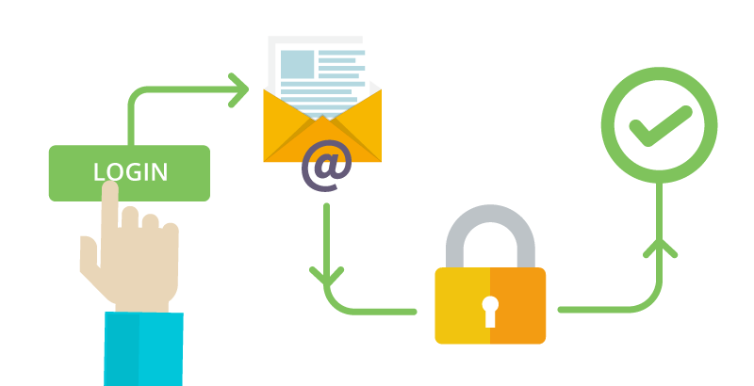
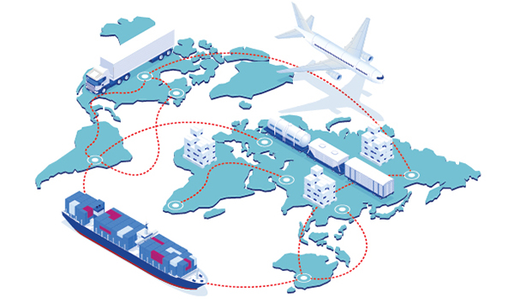
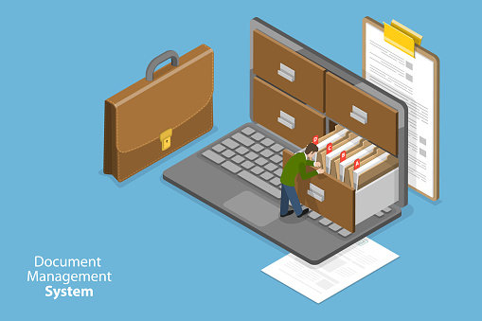

Core Features of Trade Finance Blockchain Explorer
User Authentication & Authorization
JWT-based secure login
Role-based access (Importer, Exporter, Bank, Admin)
Trade Management
Create and manage trade requests
Update trade status securely
Track trade lifecycle transparently
Document Management with S3
Upload trade documents to Amazon S3
Store document metadata in database
Generate SHA-256 hash at upload time
Blockchain-Based Verification
Hash stored and compared during verification
Detects any document tampering
Provides immutable audit trail

Slide 4




Role-Based Access Control (RBAC) of Trade Finance Blockchain Explorer
Corporate
Uploads invoices, BLs, LoCs
Represents exporters/importers
Cannot approve or audit
Bank
Verifies documents
Approves trades & releases payments
Cannot upload invoices
Auditor
Verifies integrity & ledger history
Read-only access
Cannot modify data
Admin
Manages users & roles
Configures organizations
No access to business data

Slide 5

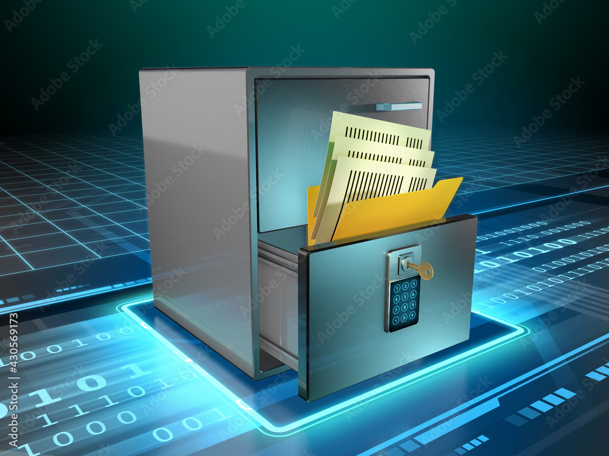
Challenges & Solutions in Trade Finance
Challenges:
Manual document handling
Risk of document forgery
Lack of transparency
Slow verification process
Solutions:
Document Security: Documents stored in Amazon S3 with hash verification to prevent tampering
Data Integrity: Blockchain-based hash comparison ensures records cannot be altered
Storage Scalability: Cloud-based S3 object storage supports large-scale document handling
Trust Between Stakeholders: Immutable blockchain ledger provides a single source of truth

Slide 6



API Modules & Data Models Implemented
API Modules
Auth Module
User registration & login using JWT
POST /api/auth/register – Register User
POST /api/auth/login – User Login
Users Module
Fetch current user and all users
GET /api/users/me – Get Current User
GET /api/users/ – Get All Users
Documents Module
Upload documents to Amazon S3
List, update, and verify document hash
POST /api/documents/upload – Upload Document to S3
GET /api/documents/list – List Documents
GET /api/documents/{document_id} – Get Document
POST /api/documents/verify-hash/{document_id} – Verify Document Hash
PUT /api/documents/update/{document_id} – Update Document
GET /api/documents/my – My Documents

Slide 7
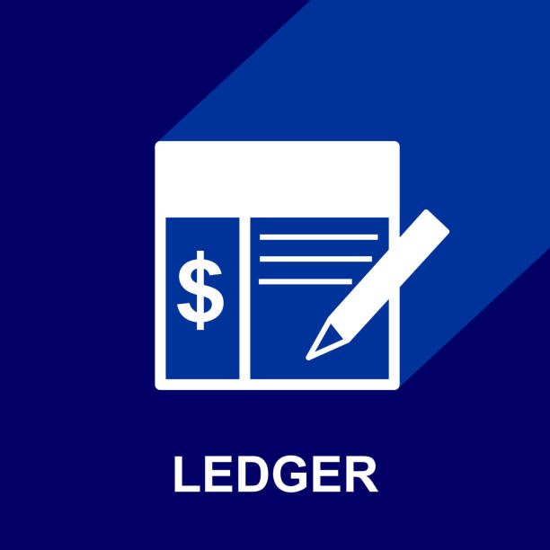



API Modules & Data Models Implemented
API Modules
Ledger Module
Blockchain ledger entries & audit trail
GET /api/ledger/entries/all – Get All Ledger Entries
GET /api/ledger/entries/document/{document_id} – Document Ledger History
GET /api/ledger/stats – Ledger Statistics
Trades Module
Create trades, update status, view trades
POST /api/trades/ – Create Trade
PUT /api/trades/{trade_id}/status – Update Trade Status
GET /api/trades/my – Get My Trades
GET /api/trades/all – Get All Trades
Risk Module
Trade risk calculation and analysis
POST /api/risk/recalculate – Recalculate Trade Risk
GET /api/risk/my – Get My Risk Score
Analytics Module
Trade summary & risk insights
GET /api/analytics/trades/summary – Trade Summary
GET /api/analytics/risk/summary – Risk Summary

Slide 8




Measurable Outcomes and Impact
100% secure document storage using Amazon S3
Tamper-proof verification using blockchain hashing
Faster document validation
Improved transparency in trade finance

Slide 9
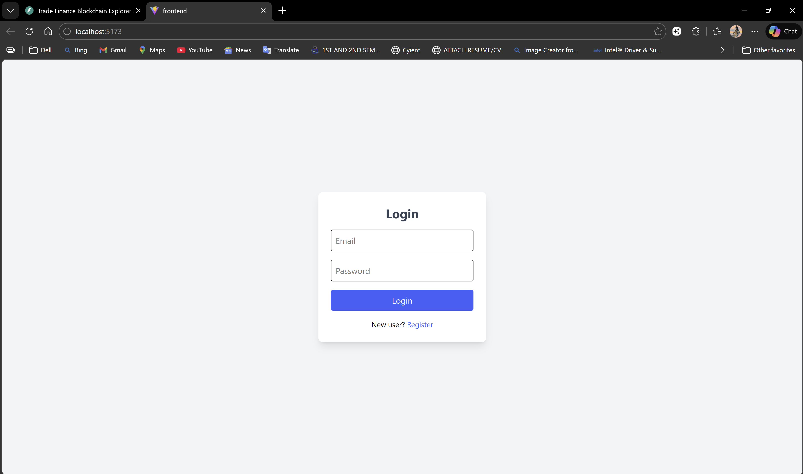
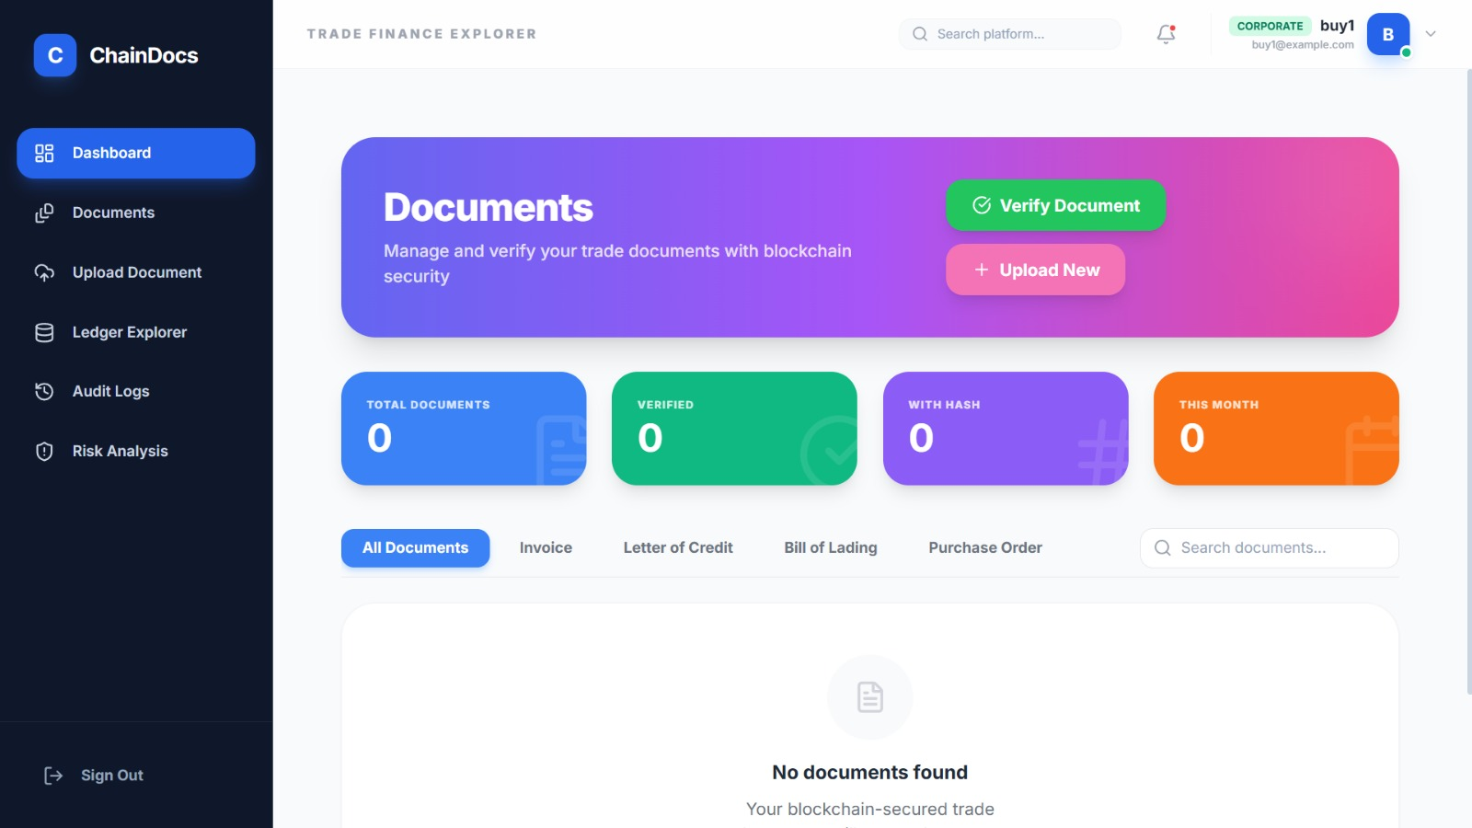
Figure 1: User Login Interface
Secure authentication screen allowing users to log in using email and password with JWT-based access control.
Figure 2: Documents Dashboard
Centralized dashboard to manage and verify trade documents using blockchain-backed security with quick actions for upload and verification.

Slide 10
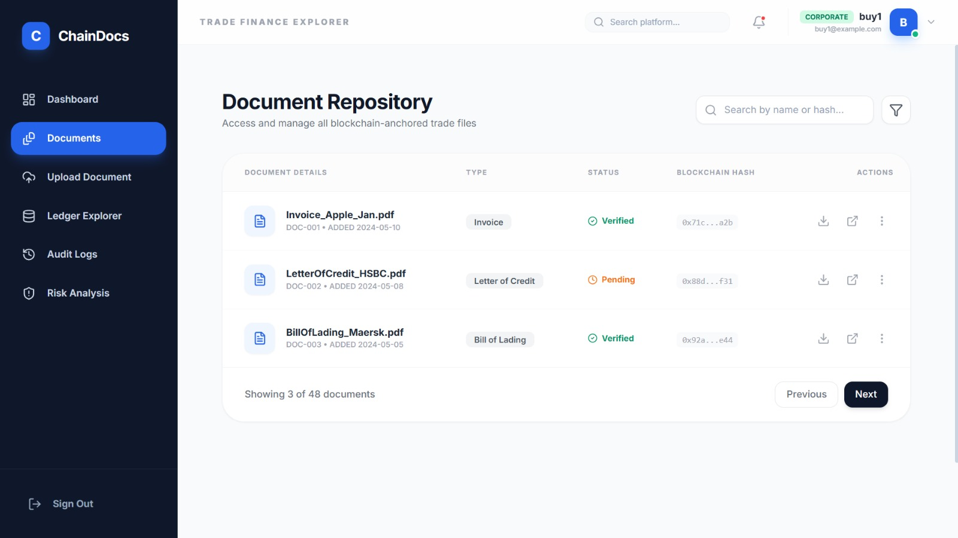
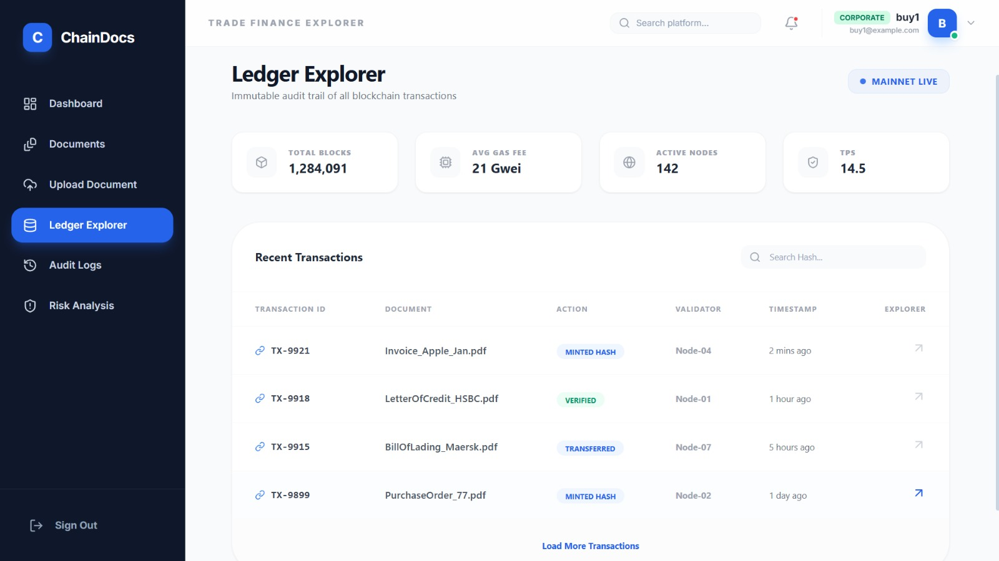
Figure 3: Document Repository View
Repository listing uploaded trade documents such as invoices, letters of credit, and bills of lading with verification status and blockchain hash details.
Figure 4: Ledger Explorer
Blockchain ledger explorer displaying immutable transaction records, including document hash minting, verification actions, and timestamps.

Slide 11
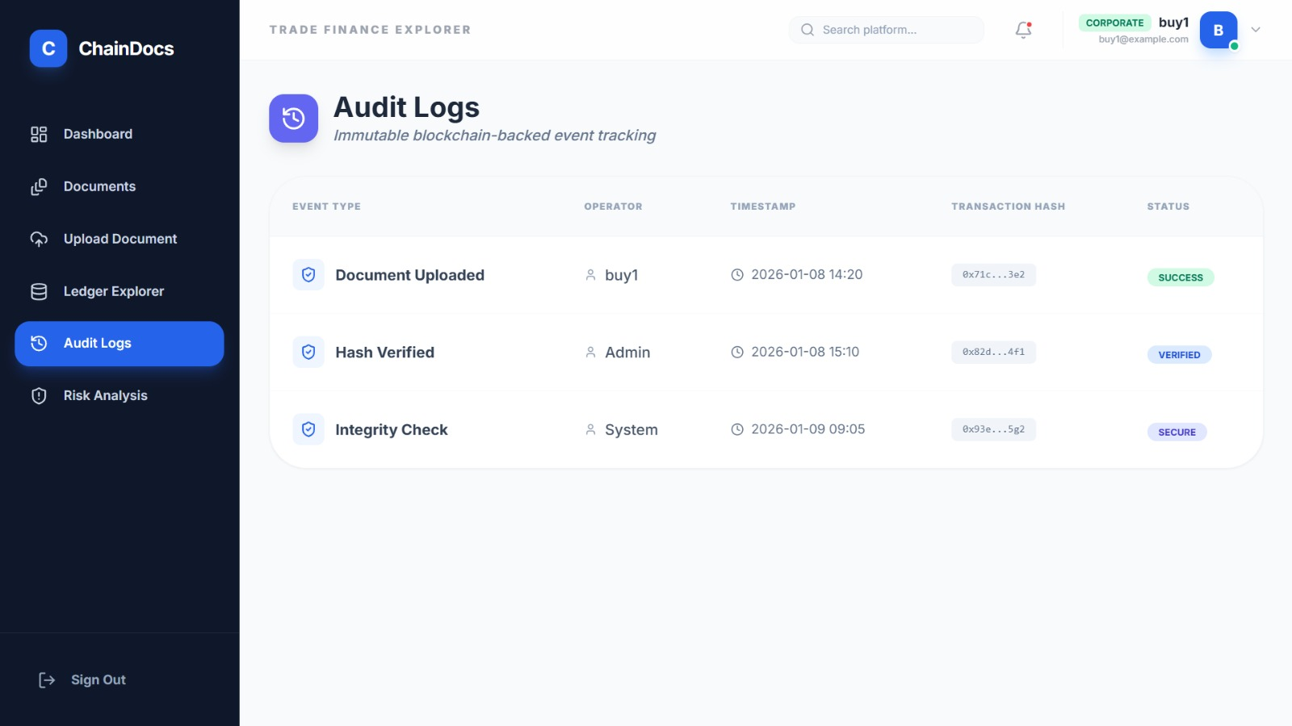
Figure 5: Audit Logs
Immutable audit log tracking document events such as upload, hash verification, and integrity checks to ensure transparency and traceability.
Figure 6: Risk Analysis Dashboard
Risk analysis module providing trade risk evaluation based on document status, verification history, and blockchain audit data to support informed decision-making.

Slide 12

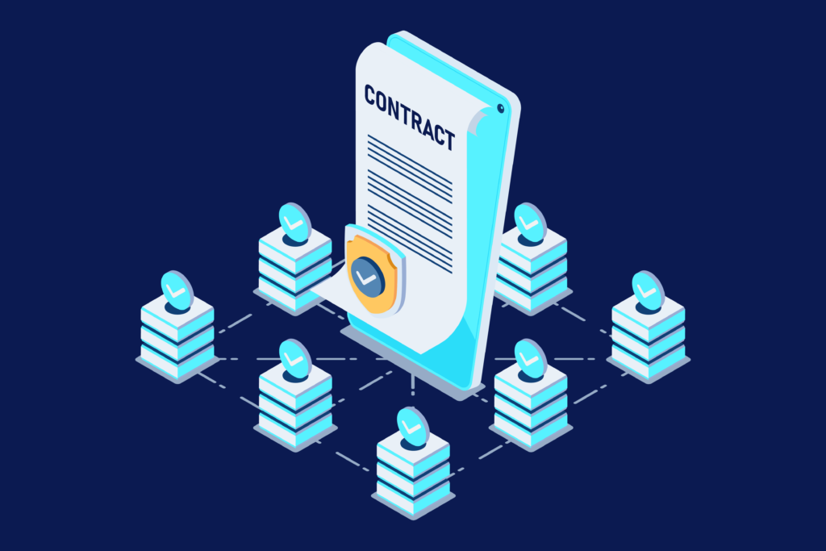

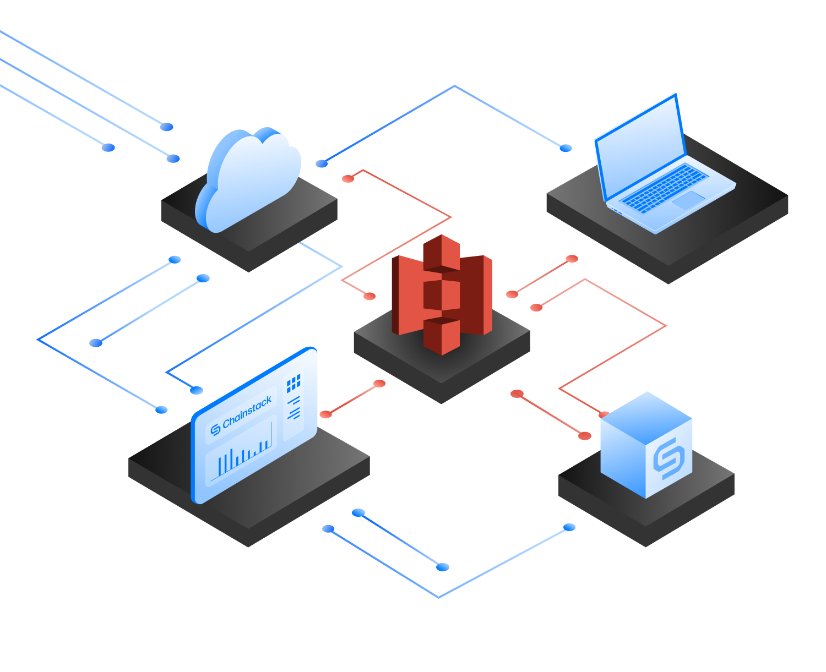
Future Enhancements
Real blockchain integration (Ethereum / Hyperledger)
Smart contracts for trade automation
Multi-bank ecosystem integration
IPFS + S3 hybrid storage

Slide 13
Team Members
S Nithin
Chetan Tirumani
Dipendra Mahato
Tiru Ram Narla
Garima Tyagi
Sarveswar Raj

Slide 14
Presentation Video...
https://drive.google.com/file/d/1HZGIS0neWCP8rh9bqwuUkyBOCvw3RH5... | TF-GroupB | Microsoft Teams

Slide 15
Q & A

Slide 16


